Slide 1


Semantic Song Search
Finding Meaning in Lyrics
Team 13
Henry Savich
Mahmoud Hamza
Shea Conaway

Slide 2
Recap Project Goals
Build a search engine for song lyrics
Better, more meaningful results than keywords
Songs are metaphorical and diverse in topic
Ability to rank by relevance
Notes:
150,000 songs with more than 10,000 views
1,200 song with more than 1,000,000
Song lyrics database (6mil songs)
Filter by language and popularity

Slide 3
Technologies & Methodology
Fundamental NLP technique is representing words as vectors called embeddings
Lyrics with similar vectors have similar meaning
Similarity is measured by difference in angle
Our goal is to train a transformer model that encodes lyrics into high-quality embeddings for searching
Words in a Example Semantic Space
Entertaining
"youtube"
"lecture"
Unimportant
Important
"textbook"
Boring

Slide 4
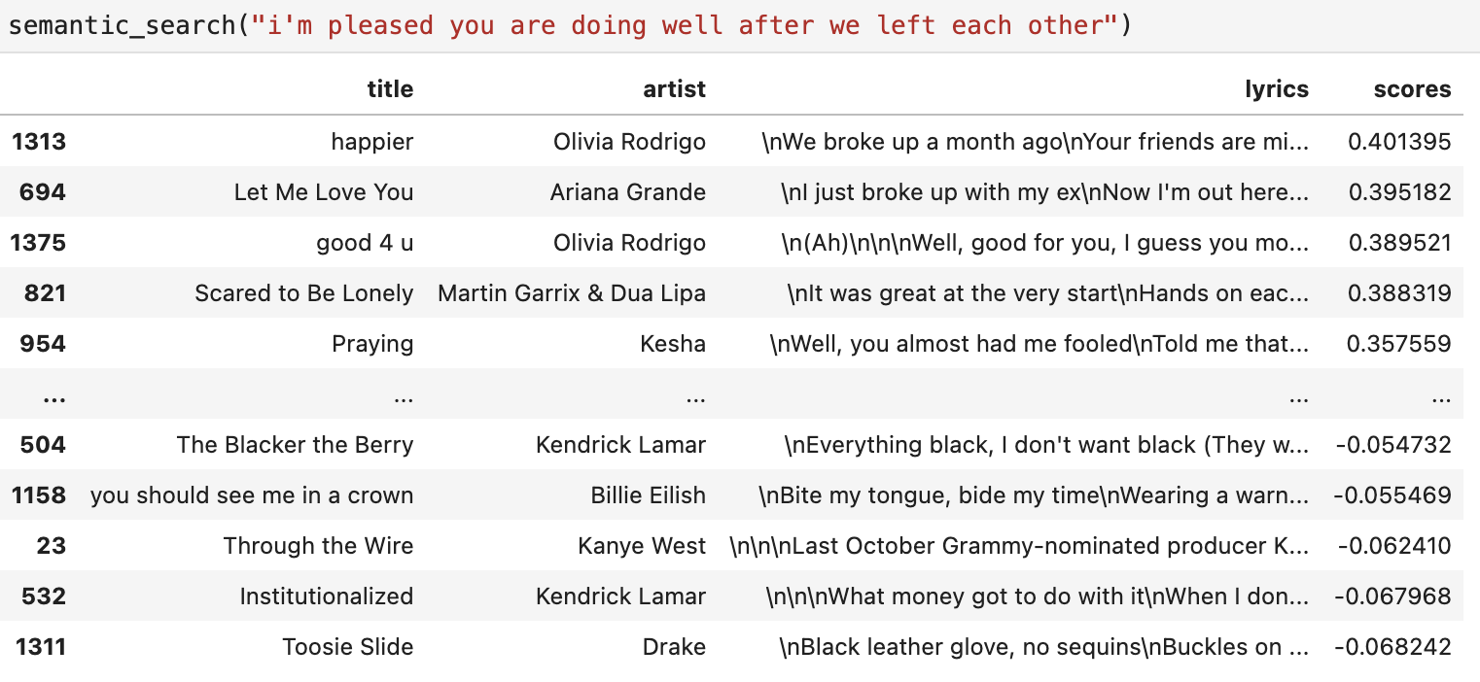
Baseline Progress
Matches by meaning
Better than keyword search
Notes:
Baseline model with no training
Not strong enough distinction from keyword
What do we know about original (pre-)training set?
Some good results, some bad
Examples
Thoughts on what re-training will help with
Metaphors
Specialize on song topics (love, betrayal, adventure, braggadocio)

Slide 5
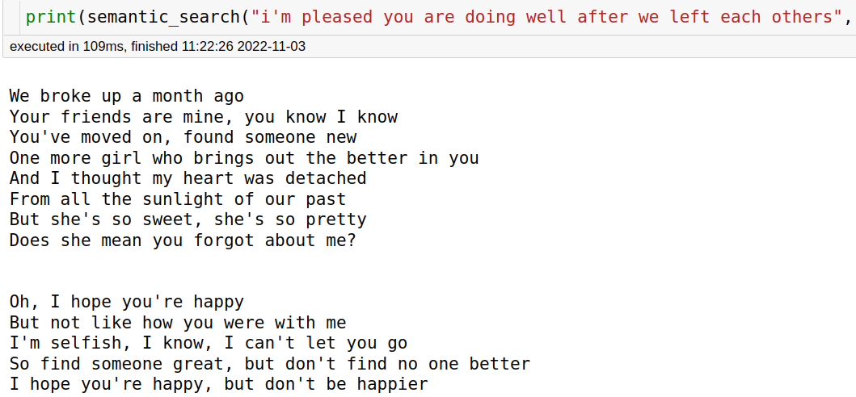

Slide 6
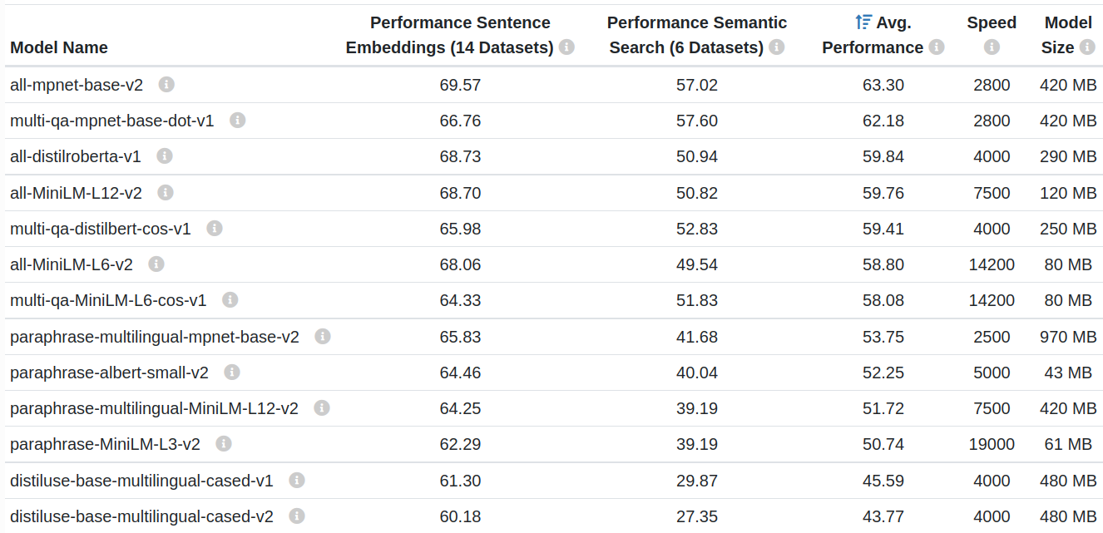
Model selection
Notes:
Make red labels on models
The all-* models where trained on all available training data (more than 1 billion training pairs) and are designed as general purpose models. The all-mpnet-base-v2 model provides the best quality, while all-MiniLM-L6-v2 is 5 times faster and still offers good quality.
We went for all-MiniLM-L12-v2
Baseline model with no training
Not strong enough distinction from keyword
What do we know about original (pre-)training set?
Some good results, some bad
Examples
Thoughts on what re-training will help with
Metaphors
Specialize on song topics (love, betrayal, adventure, braggadocio)

Slide 7
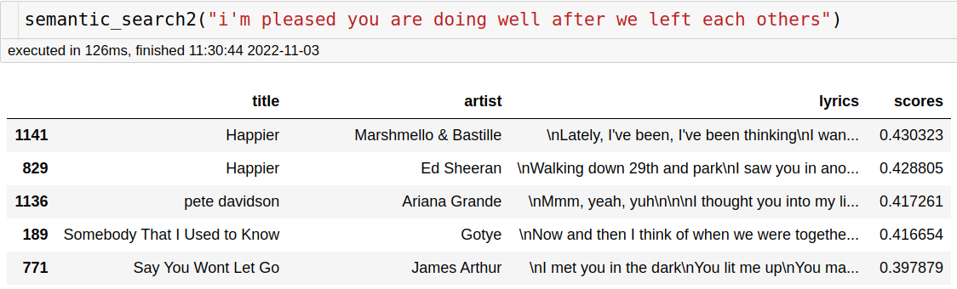
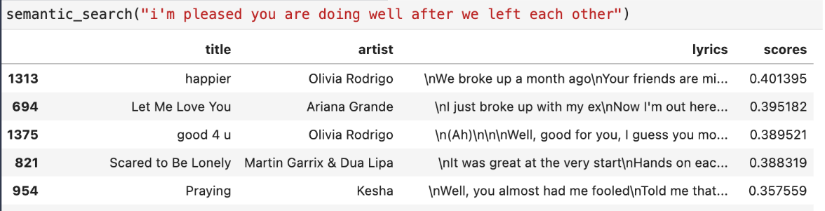
What if we changed models?
The fastest model
Original model
Notes:
We get happier again
However the score changes greatly
We need an objective metric

Slide 8
Challenges:
Present and Future
Model robustness
How good is our model at dealing with “dirty” data?
Are we using the best data set for our task?
Quantifying a “good” search model
No ground truth
Inescapably subjective
Labor-intensive to make labeled data
Use related evaluation sets

Slide 9

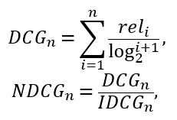
Testing Metric Plans
Hand-label song relevance to certain queries
Relevance is cosine similarity between embeddings
Use normalized discounted cumulative gain to judge our sentence transformer models

Slide 10
Next Steps
Build up a labeled dataset
Explore how different sentence transformers perform
Can we get a more “metaphorical” embedding?
Fine-tune the best model to further improve performance

